Slide 1

Enhancing U-Net for PCB Segmentation Using Hyperspectral Imaging in E-waste Recycling
School of Mechanical and Control Engineering
Bachelor’s Thesis Presentation
Thesis Advisor: Prof. Young-keun, Kim
21900575 Lee ChanKeun

Slide 2
Table of Contents
1. Introduction
2. Datasets and Methods
3. Results
4. Discussion
5. Conclusion

Slide 3
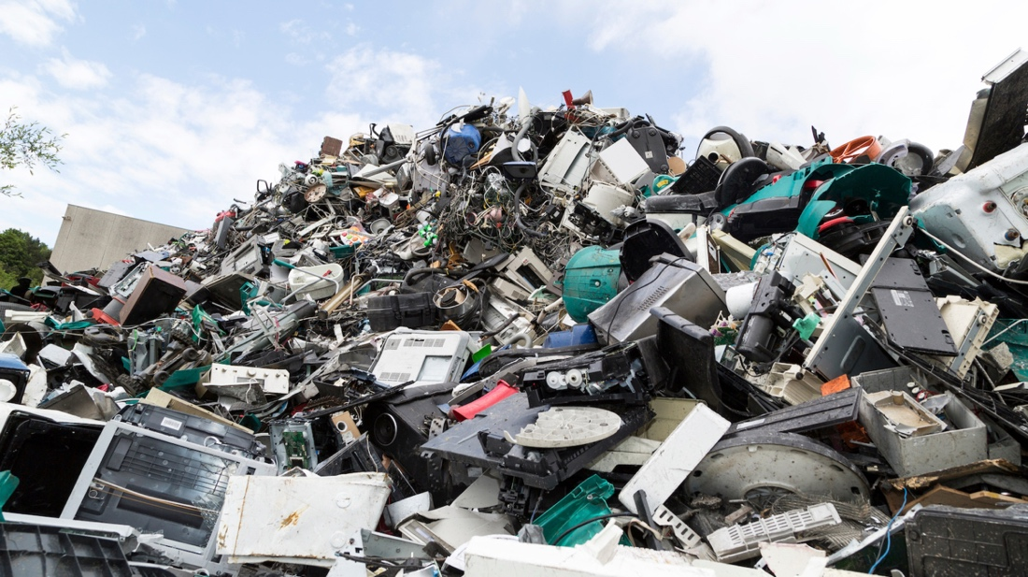
1. Introduction
Background and Motivation
Notes:
Global generation of electronic waste(E-waste) surpassed 62 million tonnes in 2024 and is projected to grow at roughly 3 % annually [1]. Printed-circuit boards (PCBs) constitute only ~3 % of this mass, yet they contain > 40 % of the recoverable precious and base metals—including gold, palladium, copper, and tin [2]. Inadequate recycling not only forfeits these critical resources but also releases brominated flame retardants, lead, and dioxins into the environment. Automated optical systems capable of localizing and classifying heterogeneous PCB components are therefore pivotal for (i) economic metal recovery, (ii) pollution avoidance, and (iii) meeting circular-economy directives.

Slide 4
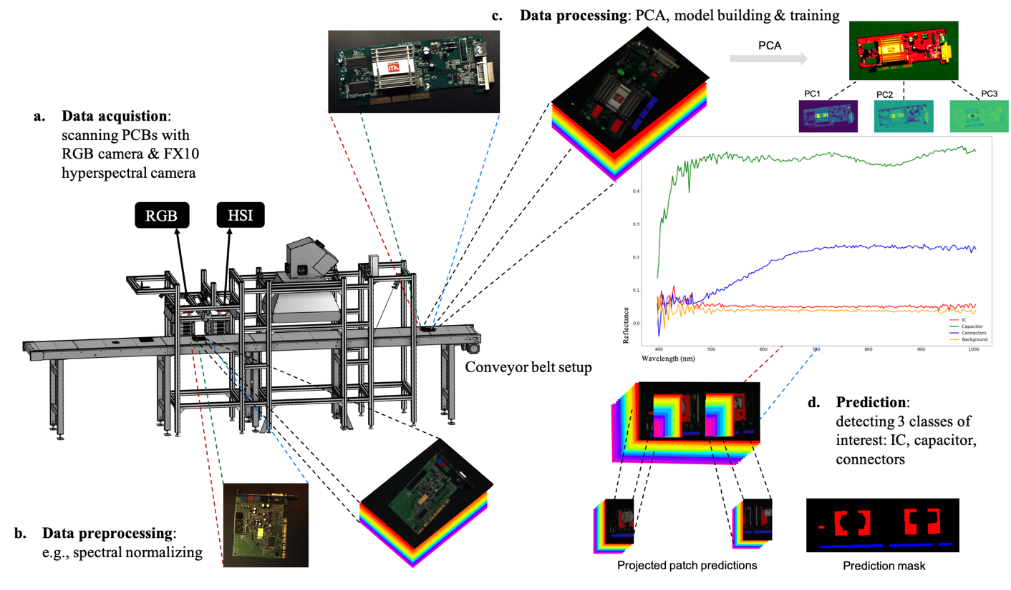
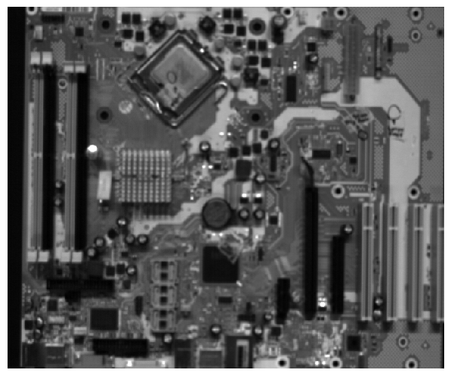
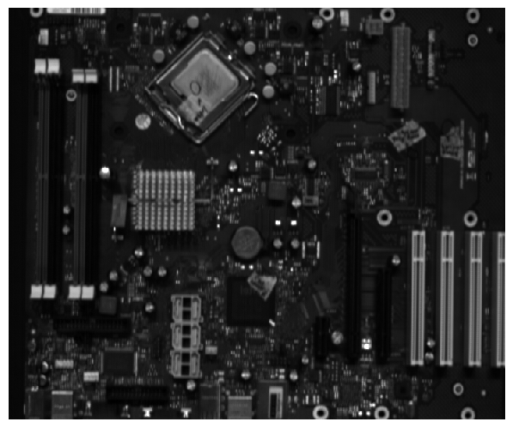
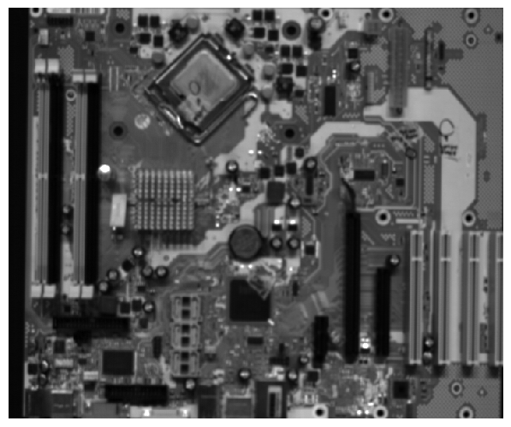
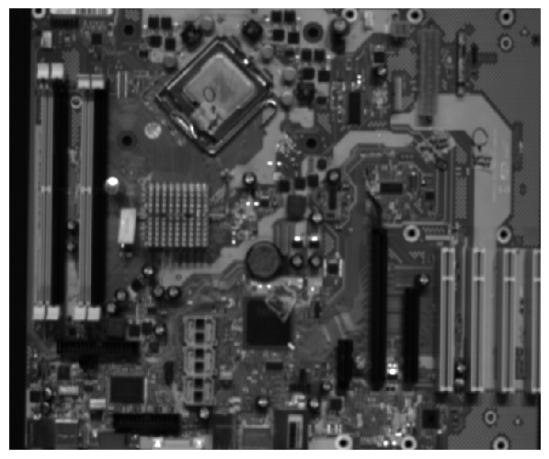
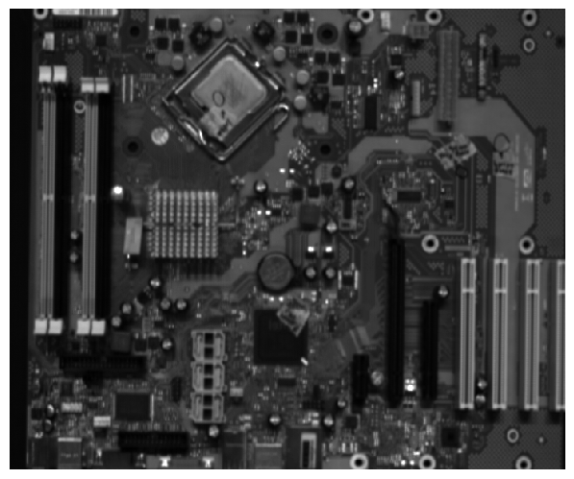
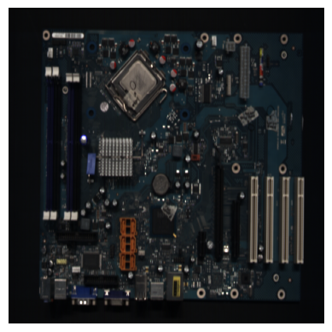
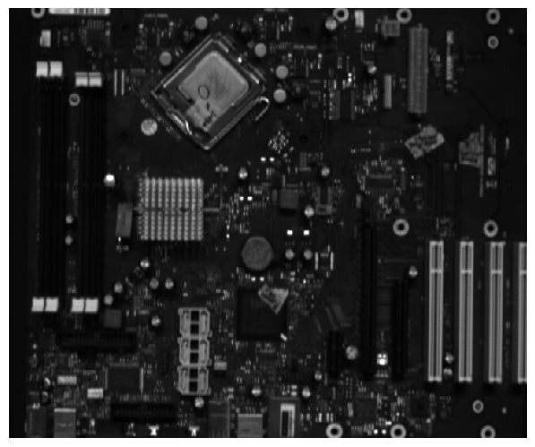
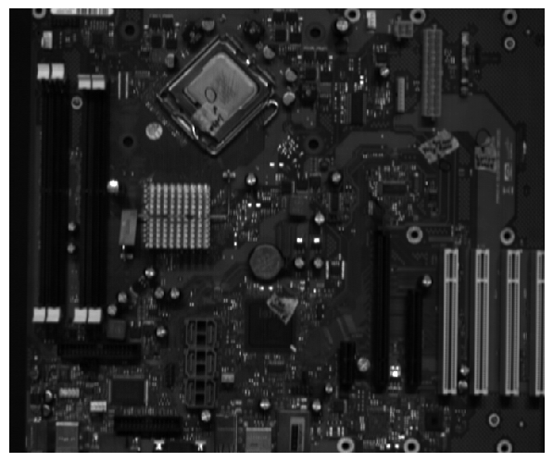
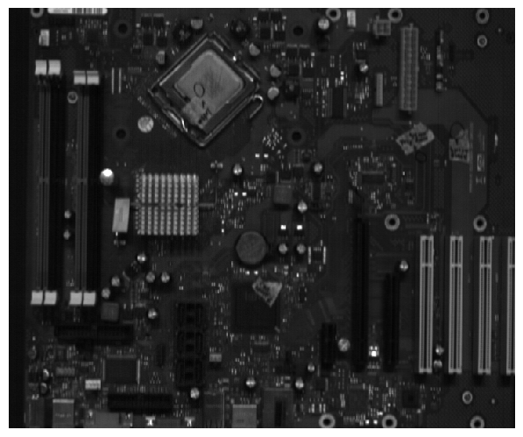
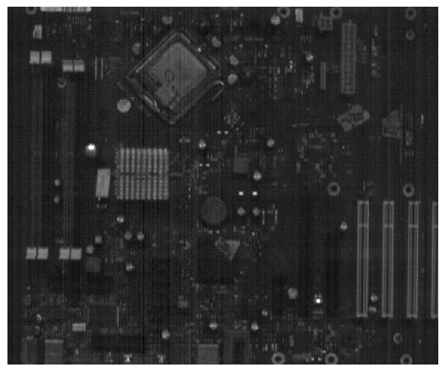
1. Introduction
950~955nm
675~680nm
400~405nm

Slide 5
2. Datasets and Methods
Strategy | Channel Count | Relation to original paper
Baseline #1(Full-Cube) | 214 bands | New – removes the patch constraint by leveraging higher GPU memory; serves as an upper-bound reference.
Baseline #2(PCA-3) | 3 bands (PCA preprocessed data) | Matches the PCA experiment in PCB-Vision after resizing; provides the lower-bound reference.
Proposed(Spectrum Channel Reduction Block) | 214 bands(214 – 128 - 3) | Replaces off-line PCA by an in-network, non-linear compression (SCRB).

Slide 6
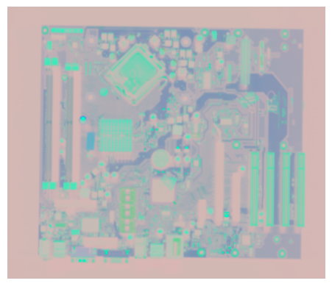
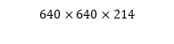
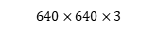
2. Datasets and Methods
Baseline #1(Full-Cube)
Baseline #2(PCA-3)
Spectrum Channel Reduction Block (Proposed)
214 channels
$$640×640×214$$
$$640×640×3$$
Spectrum Channel Reduction Block
Backbone Deep Learning Model

Slide 7
2. Datasets and Methods
214
3
64
128
64
4
HSI-Input
640x640
Spectrum Channel Reduction Block
640x640
640x640
640x640
640x640
640x640
128
3
128
128
128
128
320x320
320x320
320x320
Spectrum Channel Reduction Block
256
640x640
256
640x640
160x160
160x160
160x160
160x160
256
512
256
80x80
80x80
512
Copy and crop
1024
Max pool 2x2
40x40
Double CONV, ReLU
Up-CONV 2x2
CONV 1x1

Slide 8
2. Datasets and Methods
Item | Setting
Hardware | Windows 11, Python 3.12, PyTorch 2.7, CUDA 12.8, single NVIDIA RTX A6000(48 GB)
Epochs/ Batch size | 100 epochs, batch 8
Loss | Weighted cross-entropy, class weights = [0.1, 0.7, 0.95, 0.8]
Early stopping | Patience = 20 epochs on validation loss
Data augmentation | 90° rotations, horizontal + vertical flips (p = 0.5 each)
Dataset split | Train 126, Validation 3, Test 30 (identical across all inputs)

Slide 9
3. Results
Metric | Base Architecture | SCRB | Others | IC | Capacitor | Connectors
F1 Score | U-net | Baseline #1 Baseline #2 Proposed | 0.95 0.95 0.96 | 0.75 0.27 0.67 | 0.57 0.23 0.58 | 0.31 0.05 0.46
 | Attention U-net | Baseline #1 Baseline #2 Proposed | 0.97 0.94 0.96 | 0.71 0.25 0.70 | 0.65 0.23 0.36 | 0.66 0.10 0.54
 | ResU-net | Baseline #1 Baseline #2 Proposed | 0.96 0.94 0.97 | 0.74 0.14 0.72 | 0.53 0.16 0.56 | 0.51 0.02 0.71
Metric | Base Architecture | SCRB | Others | IC | Capacitor | Connectors
IoU | U-net | Baseline #1 Baseline #2 Proposed | 0.91 0.95 0.93 | 0.60 0.27 0.51 | 0.40 0.23 0.41 | 0.18 0.05 0.30
 | Attention U-net | Baseline #1 Baseline #2 Proposed | 0.95 0.90 0.93 | 0.56 0.14 0.54 | 0.49 0.13 0.22 | 0.49 0.05 0.37
 | ResU-net | Baseline #1 Baseline #2 Proposed | 0.94 0.90 0.94 | 0.59 0.07 0.56 | 0.36 0.08 0.39 | 0.34 0.01 0.55

Slide 10
3. Results
Base Architecture | SCRB | GFLOPs | Params(M)
U-net | Baseline #1 Baseline #2 Proposed | 392.12 342.86 353.83 | 31.16 31.30 31.07
Attention U-net | Baseline #1 Baseline #2 Proposed | 466.67 417.49 428.57 | 35.0 35.14 34.91
ResU-net | Baseline #1 Baseline #2 Proposed | 606.03 506.99 518.06 | 13.29 13.30 13.07
Base Architecture | SCRB | mIoU | Mean F1 Score
U-net | Baseline #1 Baseline #2 Proposed | 0.52 0.37 0.53 | 0.64 0.37 0.66
Attention U-net | Baseline #1 Baseline #2 Proposed | 0.62 0.30 0.51 | 0.74 0.38 0.64
ResU-net | Baseline #1 Baseline #2 Proposed | 0.55 0.26 0.61 | 0.68 0.31 0.74

Slide 11
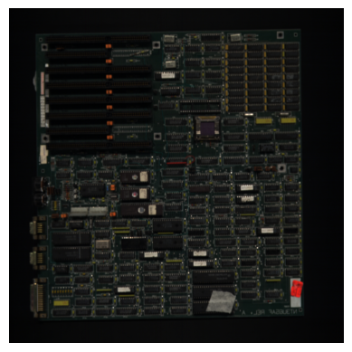
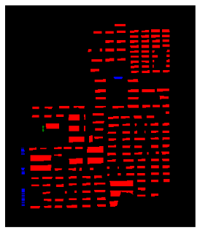
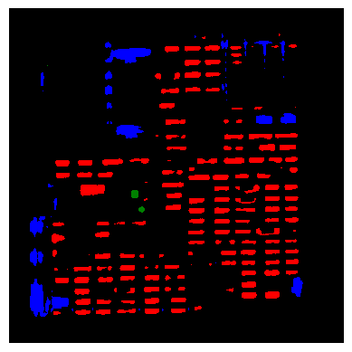
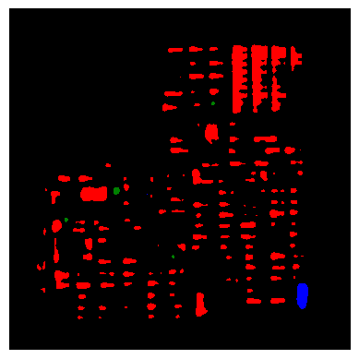
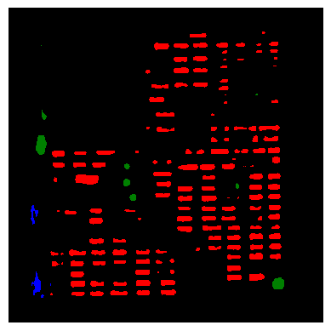
3. Results
Original Image
Ground Truth Mask
Baseline #1
Baseline #2
Proposed

Slide 12
4. Discussion
Computational efficiency
U-Net. SCRB trims ≈ 10 % of the GFLOPs relative to the 214-band baseline (353.8 vs 392.1 G) while even shaving a small number of weights (31.07 M vs 31.16 M).
Attention U-Net. A similar reduction (8 %) is observed (428.6 vs 466.7 G) with a negligible 0.3 % parameter drop.
ResU-Net. The absolute saving is largest: 88 GFLOPs (−14 %) compared with Baseline #1.

Slide 13
4. Discussion
Segmentation accuracy
U-Net. Mean IoU and F1 climb from 0.37 → 0.53 and 0.37 → 0.66, respectively, eclipsing the original full-band scores (0.52/0.64)
ResU-Net. SCRB delivers the strongest gain: +0.06 mIoU and +0.06 F1 over Baseline #1, turning the residual backbone into the new top performer (0.61 / 0.74).
Attention U-Net. Accuracy drops relative to its 214-band counterpart (−0.11 mIoU, −0.10 F1) yet still almost doubles PCA-3 performance, indicating that attention gates alone cannot compensate for spectra removed by linear PCA but work synergistically with SCRB.
Notes:
Table 6 confirms that adaptive channel reduction recovers— and in two cases surpasses—full-spectrum accuracy while obliterating the severe degradation seen with PCA-3:

Slide 14
4. Discussion
Backbone-specific observations
1. Residual connections benefit most from SCRB
2. Attention gating adds value only when spectral cues remain intact.
3. Parameter counts are stable
Limitations and future work
IC class still lags
Dataset Scale

Slide 15
5. Conclusion
Cut floating-point operations by 8–14 % relative to the 214-band models,
Doubled mean IoU and F1 with respect to linear PCA input

